Slide 1

WEYLAND ENERGY
What Millbrook Solar & Storage will look like
Public consultation #3 · 16 September 2026

Slide 2

Viewpoint 1 – footpath FP14 today
Winter 2026

Slide 3

Viewpoint 1 – year 15 with mitigation
30 m corridor, wildflower margins, church view kept open

Slide 4

Viewpoint 3 – Mill Lane Cottages, year 15
3 m native hedgerow screen
Notes:
Expect questions from the cottage residents – Liam has the glare study.

Slide 5
Viewpoint 6 – Beacon Hill, year 15

Slide 6
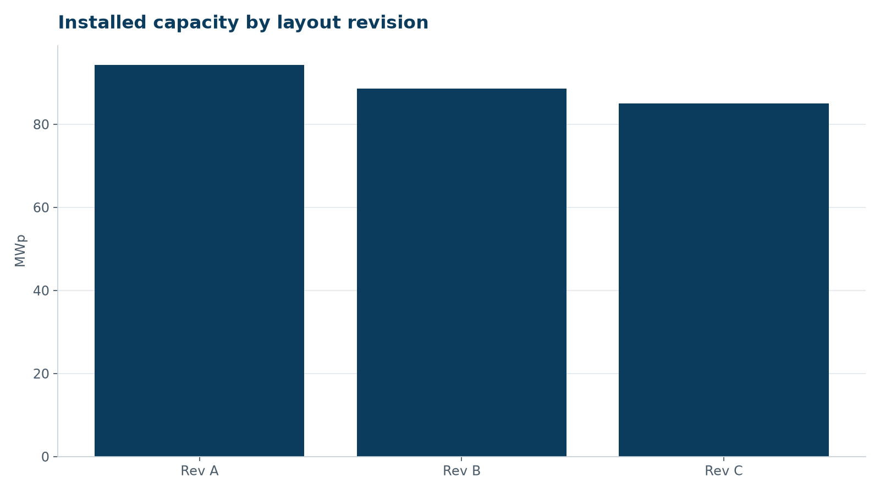
How we got here
• Rev A: 94.2 MWp → Rev C: 85.0 MWp
• Field 7 removed
• FP14 corridor doubled to 30 m
• 50 m setback from Mill Lane
WEYLAND ENERGY · Millbrook – what it will look like
6

Slide 7
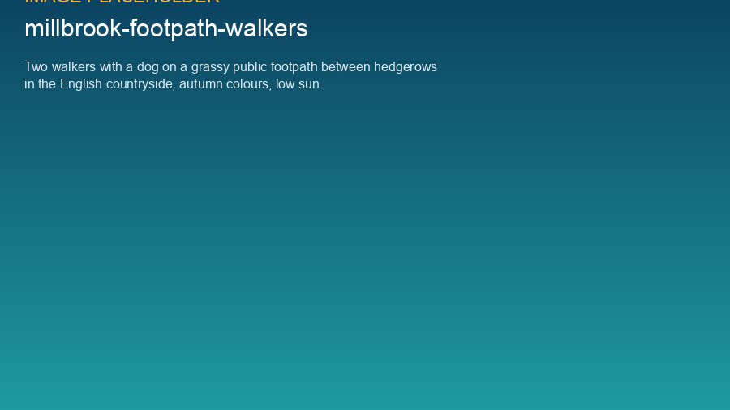
WEYLAND ENERGY
Thank you
Feedback until 30 September · millbrook@weyland-energy.example

